Slide 1

THE IMPACT OF REMOTE WORK ON MENTAL HEALTH AMONG NORTH AMERICAN WORKERS

Slide 2
Research Questions

Slide 3
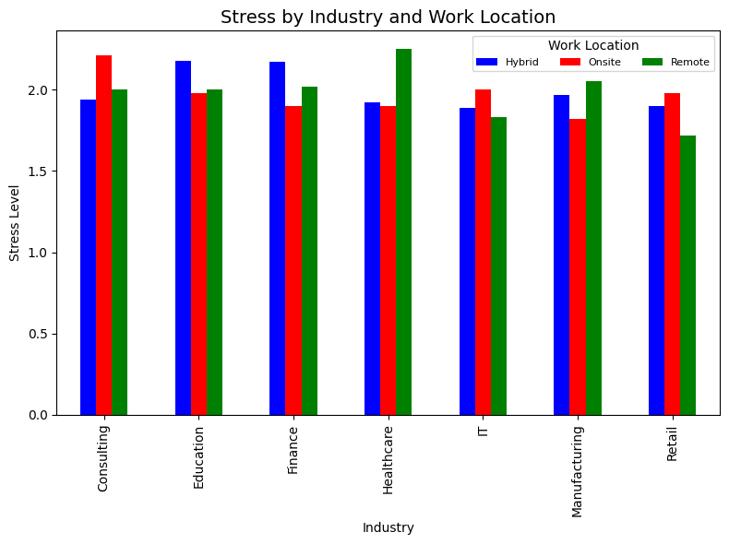
How do stress levels vary across different industries in remote work environments?
In North America, remote workers felt less stress than other work locations
Though most industries show less stress working remotely, we would have still expected a larger decrease in stress working remotely

Slide 4
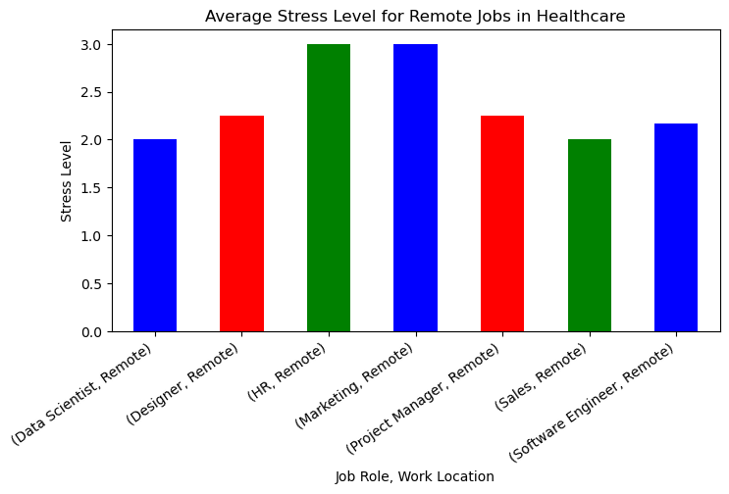
How do stress levels vary across different industries in remote work environments?
Focusing on the Healthcare industry with the highest average stress level and showing wich jobs they are
HR department and Marketing
HR - managing employees
Marketing - Deadlines and constant communication
Further investigation could improve resources and stress relief

Slide 5
What is the impact of remote work on social isolation and work/life balance?
Objective: Compare the impact of Remote Work on social isolation and work-life balance to that of Onsite and Hybrid Work.
Participants:
Sample Size: 2,340 North American workers
Groups: Onsite, Hybrid, and Remote workers
Data Collection: Participants rated two factors on a 1-5 scale:
Social Isolation
Work-Life Balance

Slide 6
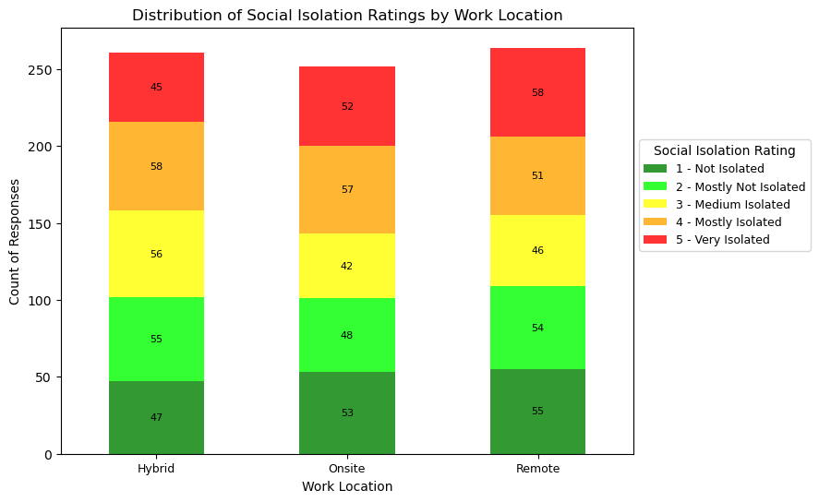
Stacked Bar Chart
This stacked bar chart shows the distribution of responses (1-5) for social isolation by work location (Onsite, Hybrid, Remote), highlighting variations across groups.is stacked bar chart shows the distribution of responses (1-5) for social isolation by work location (Onsite, Hybrid, Remote), highlighting variations across groups.
Remote Work and Social Isolation
Overall Finding:
Remote work has minimal impact on perceived social isolation, with only a 1% mean variation across Remote, Hybrid, and Onsite work settings.
Standard Deviation:
Highest in the Remote Work group, indicating greater variability in responses.
Key Observation:
Remote work was the only setting with a mode of 5, showing the highest number of respondents feeling extremely socially isolated.
Key Takeaway:
While the overall effect of remote work on social isolation is minimal, it is more likely to lead to extreme feelings of social isolation compared to hybrid or onsite work.

Slide 7
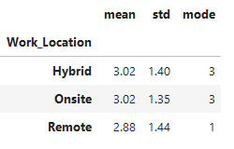
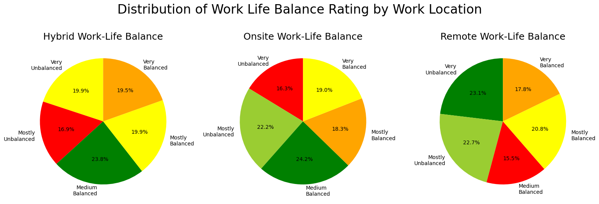
Remote Work and Work Life Balance
Overall Finding: Remote work has minimal impact on work-life balance, with only a 4.75% mean variation across work settings.
Standard Deviation and Mode: Remote work had the highest standard deviation and a mode of 1, indicating many felt their work-life balance was very unbalanced.
Key Findings: While remote work typically has little effect on work-life balance, it is more likely to lead to extreme imbalance compared to other work arrangements.

Slide 8
What is the prevalence of mental health conditions among remote workers?
Data breakdown:
* We included only North American workers
* 264 of them are remote workers
* 193 of them have a mental health condition
* There were 3 mental health conditions listed: depression, burnout and anxiety
* There were 4 categories of gender listed: Female, Male, Non-Binary and Prefer Not to Say

Slide 9
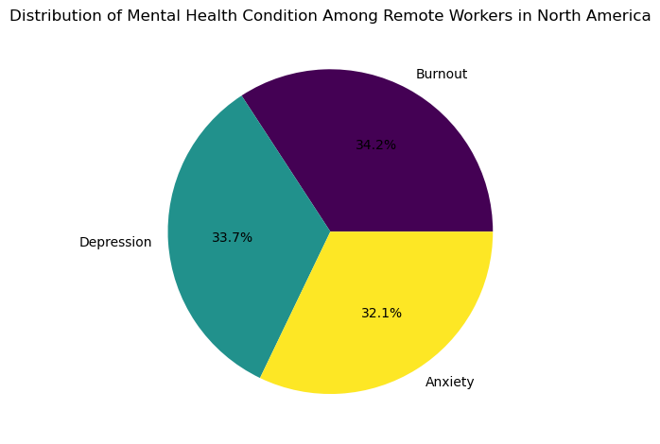
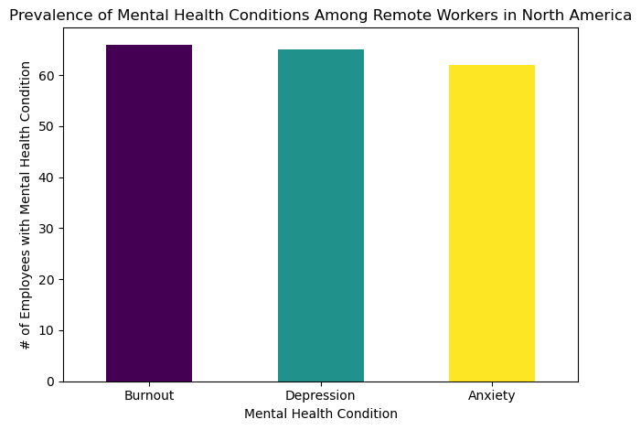
Breakdown of Mental Health Conditions

Slide 10
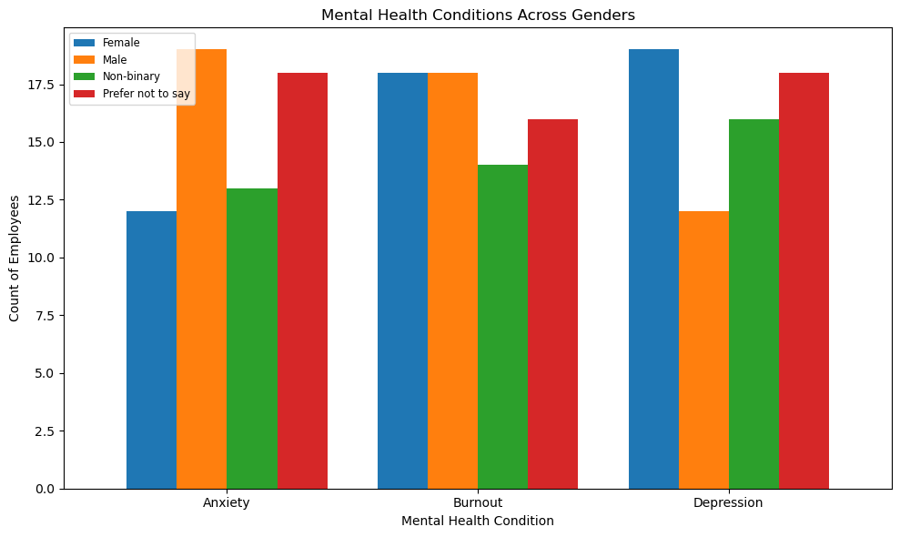
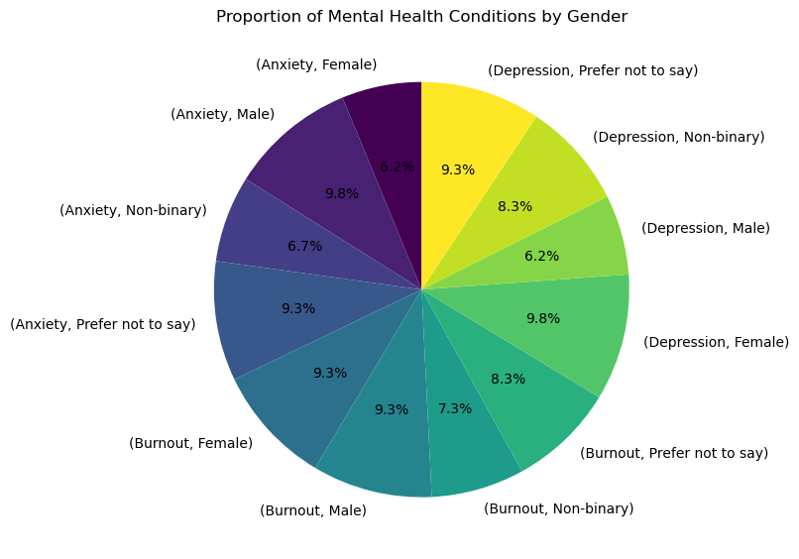
Breakdown of Mental Health Conditions by Gender

Slide 11
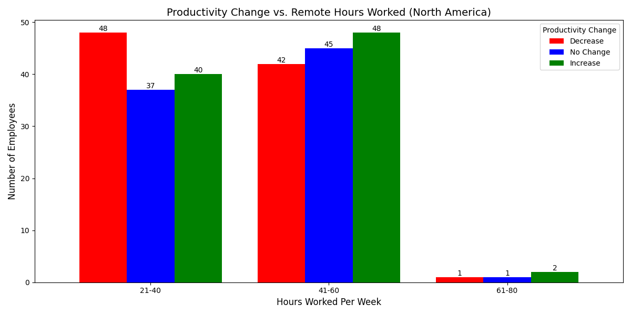
How do the number of hours worked per week and regional differences impact employee productivity in remote work environments in North America vs. Asia?
North America Remote Analysis:
The analysis shows that in North America employees who report working between 21-40 remote hours per week report the highest level of productivity decrease. The employees who reported working 41-60 hours per week reported the highest levels of increased productivity out of the three bins.
Notably most North Americans in the data set worked between 41-60 hours per week.The sample size for the employees that worked between 61-80 hours a week in North America is small and therefore does not provide clear conclusions.

Slide 12
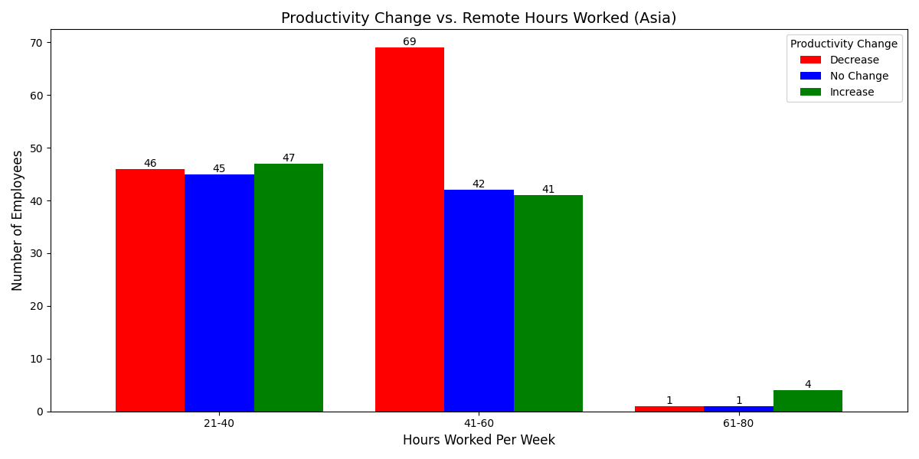
How do the number of hours worked per week and regional differences impact employee productivity in remote work environments in North America vs. Asia?
Asia Remote Analysis:
Productivity generally trends downward as weekly hours increase beyond 40.
In Asia, the employees who reported working 21-40 reported similar levels of productivity
Most Asian employees report decrease or no productivity gains when working over 41 hours per week, underscoring potential burnout or inefficiency at higher workloads.
The small sample size for employees working 61-80 hours makes it difficult to draw conclusions for this segment.

Slide 13

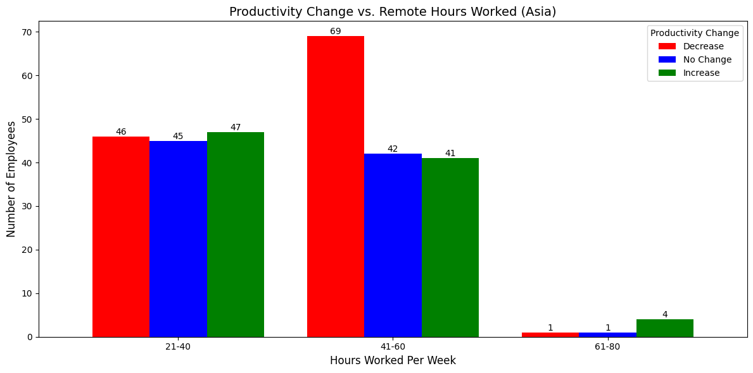
How do the number of hours worked per week and regional differences impact employee productivity in remote work environments in North America vs. Asia?
Regional Comparison:
The bar charts analyzing Productivity Change versus Remote Hours Worked Per Week for North America and Asia reveal distinct regional trends. In North America, productivity changes are relatively balanced across the 21-40 and 41-60 hour bins, with many employees reporting "No Change" or an "Increase" in productivity. In contrast, Asia shows a greater occurrence of "Decrease" in productivity within these same hour ranges, indicating potential challenges associated with longer working hours in remote settings.
Both regions have minimal representation in the 61-80 hour bin, suggesting that few employees work extensive hours. Despite this, productivity outcomes in this category vary significantly. North America shows more stable and positive productivity trends, while Asia has more variation and challenges. This could be due to differences in culture, workplace practices, or resources. These results suggest the importance of creating remote work policies and support systems that are tailored to the unique needs of each region.

Slide 14
Final Analysis
In this study, 73% of the North American remote workers have a mental health condition. It is evenly split between depression, burnout and anxiety.
Female remote workers are experiencing depression at a higher rate and male remote workers are experiencing anxiety at a higher rate.
Remote work does not have a significant impact on perceived social isolation or work-life balance when considered on average. However off the three work arrangements (remote, hybrid, onsite), remote work was the most likely to produce feelings of extreme social isolation and extreme work life imbalance. These findings suggest that while the overall impact of remote work on social isolation and work-life balance may be minimal, individual experiences can vary greatly. Further research is needed to understand the individual factors contributing to these variations in response to remote work.
We recommend that organizations carefully monitor and limit working hours to avoid burnout and optimize productivity. Providing region-specific support systems, such as better mental health resources or flexible scheduling, could also improve employee outcomes.
Stress levels across the industries in North America for each work location were very similar, but remote workers showed less stress overall.

